Slide 1

Report on Civic Issues Registered by Citizens and Deliberations done by Municipal Councillors in Mumbai
(March 2012 to December 2016)
April 2017

Slide 2
Tracking of Promises
 | BJP | SS | INC | NCP
Number of Councillors | 31 | 75 | 52 | 13
No. of main points in Manifesto | 24 | 22 | 24 | 23
No. of sub points in Manifesto | 242 | 39 | 62 | 73
No. of issues raised according to Manifesto (March 2012 to March 2016)* | 579 | 1243 | 590 | 333
Total questions raised (March 2012 to March 2016)* | 1520 | 3820 | 2421 | 785
* Data includes issues raised in all committees.

Slide 3
Civic Complaints by Citizens in Mumbai during calendar years 2012 to 2016
Issues | Complaints |  |  |  |  | Increase from 2012 to 2016 (in %)
 | 2012 | 2013 | 2014 | 2015 | 2016
Roads | 29,967 | 42,287 | 21,847 | 13,601 | 13,475 | -55%
Buildings | 19,155 | 21,125 | 17,339 | 14,999 | 16,257 | -15%
Drainage | 16,194 | 12,708 | 9,394 | 9,904 | 12,269 | -24%
Water Supply | 6,215 | 6,075 | 7,645 | 7,728 | 7,246 | 17%
Solid Waste Management (SWM) | 6,562 | 5,519 | 7,331 | 5,213 | 7,330 | 12%
License | 6,183 | 5,741 | 6,123 | 7,145 | 8,523 | 38%
Pest control | 3,123 | 3,495 | 5,048 | 4,364 | 6,078 | 95%
Garden | 1,269 | 1,468 | 1,595 | 1,307 | 1,658 | 31%
Colony Officer | 1,057 | 1,292 | 1,023 | 881 | 1,954 | 85%
Storm Water Drainage | 939 | 895 | 1,160 | 830 | 1,386 | 48%
Shop and Establishment (S & E) | 608 | 347 | 423 | 401 | 561 | -8%
Medical Officer Health (MOH) | 498 | 440 | 425 | 553 | 956 | 92%
MCGM related | 424 | 431 | 504 | 447 | 862 | 103%
Estate | 274 | 249 | 216 | 112 | 560 | 104%
Toilet | 148 | 177 | 257 | 159 | 290 | 96%
Pollution | 159 | 117 | 135 | 135 | 220 | 38%
School | 54 | 22 | 25 | 56 | 74 | 37%
Nuisance due to vagrants on municipal roads, footpaths, gardens |  |  |  |  | 1,856
Mumbai | 92,829 | 1,02,388 | 80,490 | 67,835 | 81,555 | -12%

Slide 4
Civic Complaints after adjusting for Potholes from Voice of Citizen App
Issues | Complaints |  |  |  |  | Increase from 2012 to 2016 (in %)
 | 2012 | 2013 | 2014 | 2015 | 2016
Roads | 29967 | 42287 | 21847 | 13601 | 13475 | -55%
Less Potholes (Voice of Citizen) | 24414 | 36475 | 13743 | 5925
(A) | 5553 | 5812 | 8104 | 7676 | 13475 | 143%
Other Complaints (B) | 62,862 | 60,101 | 58,643 | 54,234 | 68,080 | 8%
Total Complaints (A+B) | 68415 | 65913 | 66747 | 61910 | 81555 | 19%

Slide 5
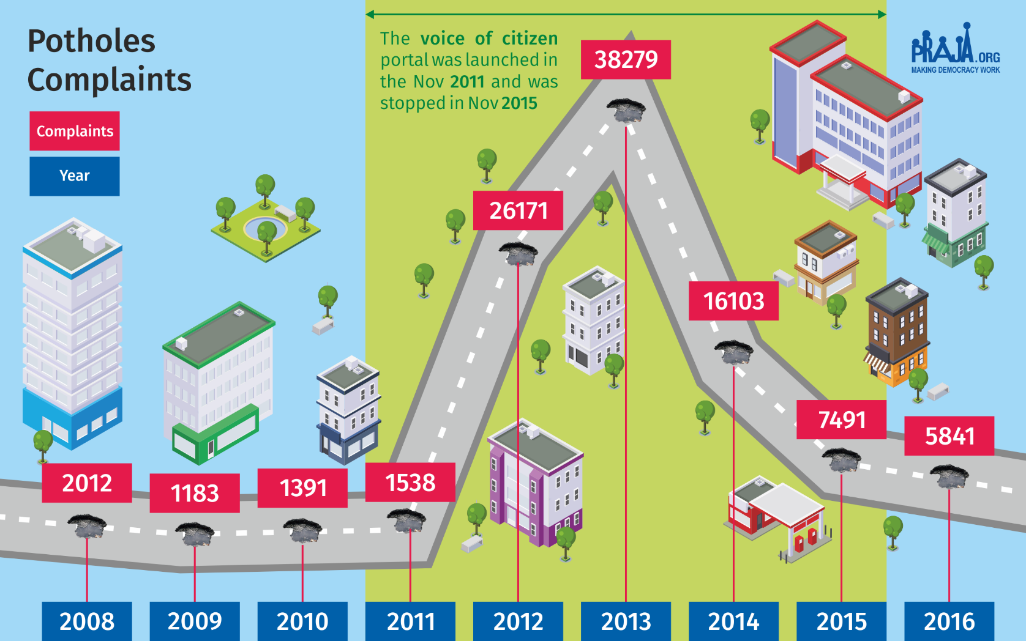

Slide 6
Category-wise of Complaints escalated in the year 2016
Complaint Type | Total Complaints Received | Escalated Complaints
 |  | Level I (AMC/Chief Engineer) | Level II (DMC) | Level III (Add. MC) | Level IV (MC)
Roads | 13,475 | 2,614 | 2,613 | 2,612 | 2,612
Buildings | 16,257 | 4,392 | 4,392 | 4,392 | 4,273
Drainage | 12,269 | 1,855 | 1,855 | 1,855 | 1,844
Water Supply | 7,246 | 2 | 2 | 2 | 2
Solid Waste Management (SWM) | 7,330 | 875 | 875 | 875 | 875
License | 8,523 | 739 | 739 | 739 | 739
Pest control | 6,078 | 167 | 167 | 167 | 167
Garden | 1,658 | 567 | 567 | 566 | 566
Colony Officer | 1,954 | 804 | 804 | 804 | 804
Storm Water Drainage | 1,386 | 230 | 230 | 230 | 228
Shop and Establishment | 561 | 68 | 68 | 68 | 68
Medical Officer Health (MOH) | 956 | 185 | 185 | 185 | 185
MCGM Related | 862 | 230 | 230 | 230 | 230
Estate | 560 | 170 | 170 | 170 | 170
Toilet | 290 | 41 | 41 | 41 | 41
Pollution | 220 | 51 | 51 | 51 | 51
School | 74 | 37 | 37 | 37 | 37
Nuisance due to vagrants on municipal roads, footpaths, gardens | 1,856 | 686 | 686 | 686 | 686
Total | 81,555 | 13,713 | 13,712 | 13,710 | 13,578
In (%) |  | 17% | 17% | 17% | 17%

Slide 7
Analysis of complaints attended (closed) in comparison with days mentioned in MCGM’s Citizen Charter
Issues/Sub-issues | To resolved as per Citizens' Charter | Actual time taken to resolve
 |  | 2014 | 2015 | 2016
Drainage
Drainage Chokes and Blockages | 1 | 17 | 8 | 11
Overflowing drains or manholes | 1 | 18 | 13 | 20
Odour ( Foul Smell ) from Drains | 1 | 16 | 14 | 20
Replacement of Missing / Damaged Manhole | 1 | 21 | 18 | 21
Raising of Manhole ( except in Monsoon ) | 7 | 14 | 11 | 17
Cleaning of septic tank | 7 | 19 | 16 | 24
Repairs to pipe sewers/main sewers | 7 | 20 | 18 | 20
Water Supply
Contaminated Water Supply | 1 | 16 | 12 | 19
Leaks in Water Lines | 7 | 17 | 14 | 18
Shortage of Water Supply | 2 | 18 | 15 | 19
Burst Water Main | 1 | 17 | 15 | 17
Solid Waste Management (SWM)
Garbage not lifted - Co-authorised Point | 1 | 16 | 15 | 17
Collection point not attended properly | 1 | 15 | 9 | 15
Garbage lorry not reported for service/ Lorry not covered | 1 | 14 | 9 | 15
Providing/removing/replacing dustbins | 8 | 17 | 9 | 18
Sweeping of road | 1 | 18 | 10 | 15
Removal of Dead Animals | 1 | 19 | 7 | 12
No attendance at public toilets | 2 | 18 | 11 | 20
Average | 3 | 17 | 13 | 16

Slide 8
Total number of Meetings, Attendance and Questions from March 2012 to December 2016
Ward Committee
Year | Total Meeting | Attend in (%) | Total Question
Mar'12 to Dec'12 | 209 | 82% | 679
Jan'13 to Dec'13 | 265 | 79% | 989
Jan'14 to Dec'14 | 298 | 71% | 972
Jan'15 to Dec'15 | 279 | 73% | 1,098
Jan'16 to Dec'16 | 279 | 72% | 1,152

Slide 9
Number of questions asked by Councillors from March 2012 to December 2016 in Ward Committees
Category | No. of Members
 | Mar'12 to Dec'12 | Jan'13 to Dec'13 | Jan'14 to Dec'14 | Jan'15 to Dec'15 | Jan'16 to Dec'16
Zero Question | 45 | 19 | 26 | 27 | 24
1 to 5 Question asked | 150 | 142 | 134 | 124 | 120
6 to 10 Question asked | 29 | 54 | 47 | 55 | 59
Above 10 Question asked | 3 | 12 | 20 | 21 | 24
Total Members | 227 | 227 | 227 | 227 | 227
88 councilors (out of 227) i.e. 38% have asked upto five questions every year.
2 councilors (Jyotsna Parmar and Ujjwala Modak) did not ask a single question in the ward committee. Ujjwala Modak was re-elected.
15 of the 88 got re-elected in March 2017. (Anil Patankar, Bina Doshi, Changez Multani, Dilshad Azmi, Geeta Gawli, Jyotshna Mehta, Kesarben Patel, Makarand Narvekar, Manoj Kotak, Pravin Shah, Ramesh Korgaonkar, Ramnarayan Barot, Sangita Handore, Shradha Jadhav, Ujjwala Modak)

Slide 10
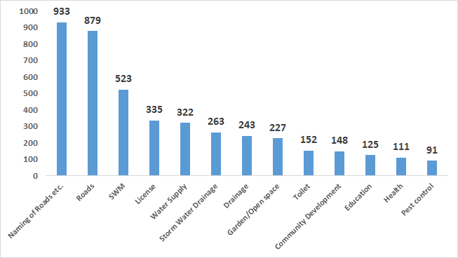
Issues raised by councillors in ward committee (March 2012 to Dec 2016)
Total question raised: 5742
Questions on Naming/ renaming of roads/Chowks: 1 out of every 6 i.e. 933
Questions on Health: 1 out of 52 i.e. 111
Question on Education: 1 out of 46 i.e. 125
Notes:
The top concern of councillors over the past 5 years has been “

Slide 11
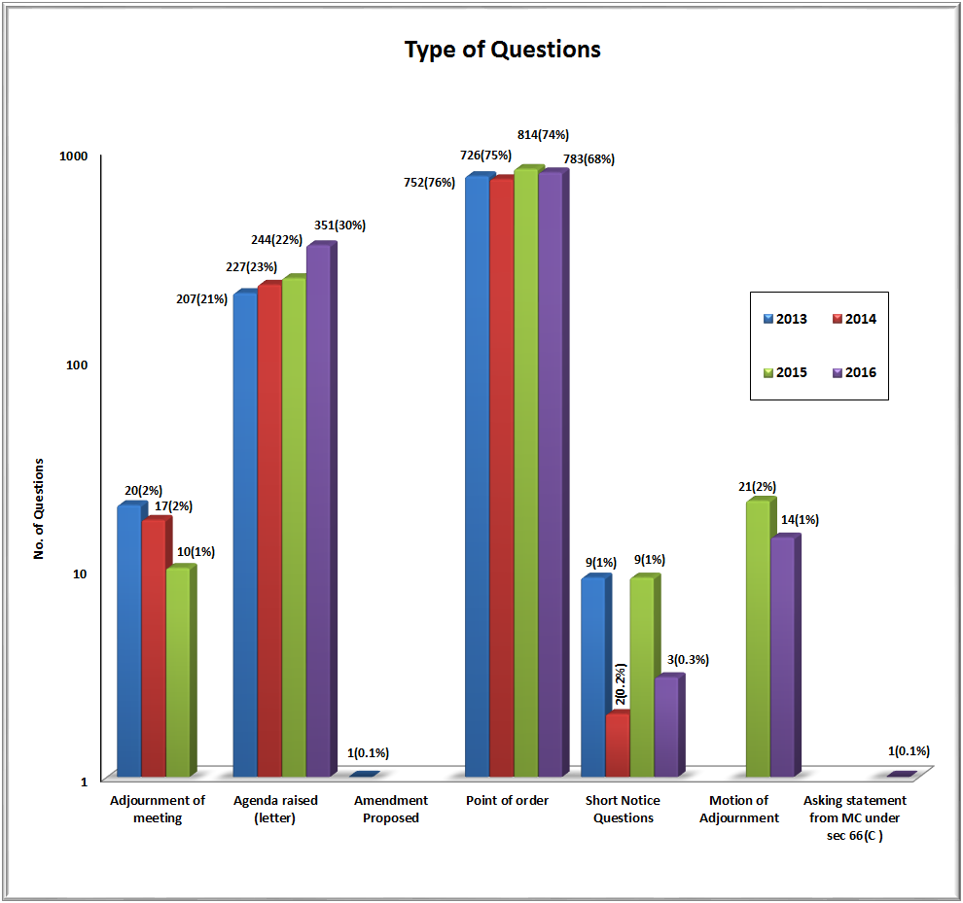
Devices used for raising questions (Jan to Dec 2016)
Out of 351 agenda raised questions 263 were on renaming, thus only 88 were on any other issue.

Slide 12
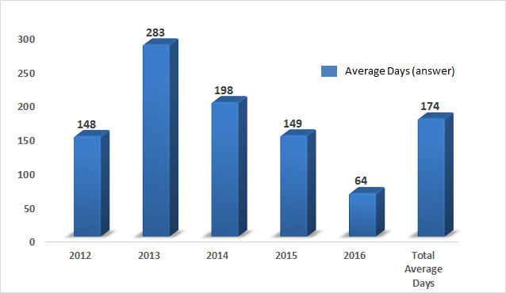
Comparison of the average days taken to answer Point of Order questions in the Ward Committees from 2012 to 2016

Slide 13
What Needs to be done
Complaints Redressal Mechanism should be: Respond in time-bound manner, User friendly and Promoted amongst citizens.
An essential for a efficient complaint system is citizen feedback – which is missing currently and needs to be bought in through complaint audits.
Administration and Councillors should use data to predict chronic wards and create a road map to resolve issues before they become crises.
Councillors should actively participate in the ward committee meetings to get effective redressal to civic issues in real time and strengthen the decentralisation principle for bringing efficacy in the service delivery of the corporation,

